Slide 1
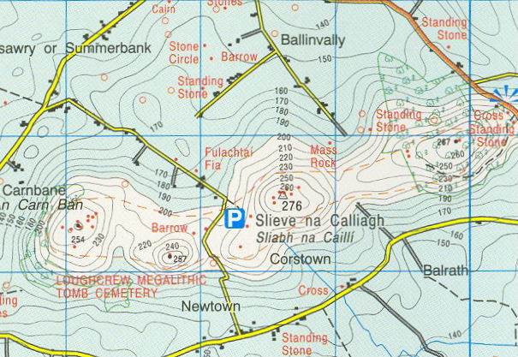
Maps and Photographs
Revision

Slide 2
Ordnance survey maps

Slide 3
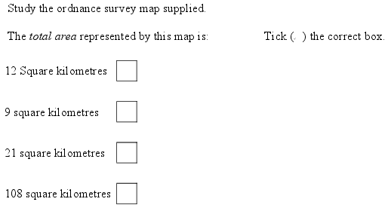

Slide 4
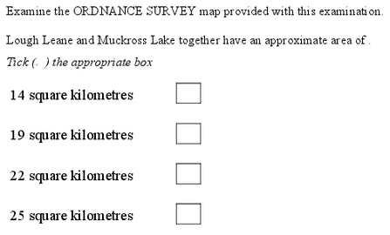

Slide 5
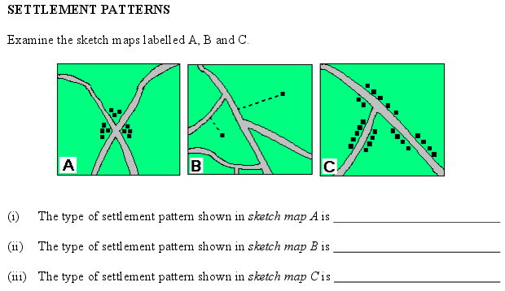
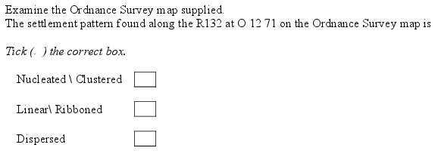

Slide 6
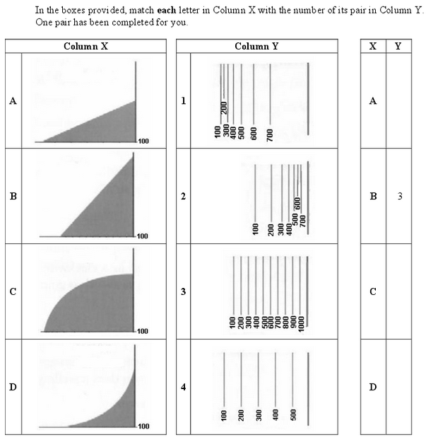

Slide 7
Common topics
Grid references
Sketch maps

Slide 9
Aerial Photographs

Slide 10
Common topics
Sketch maps

Slide 11
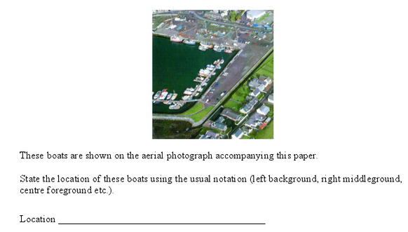

Slide 12
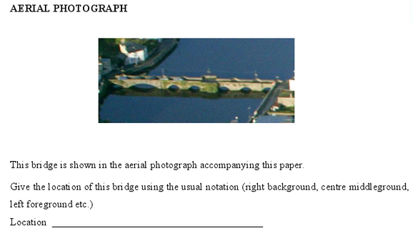

Slide 13
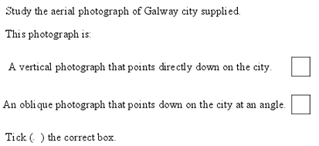

Slide 14
Maps and photographs

