Slide 1
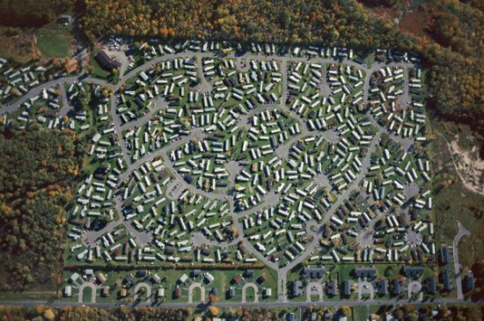
Aerial Photographs
Chapter 27

Slide 2
Vertical
Oblique

Slide 3
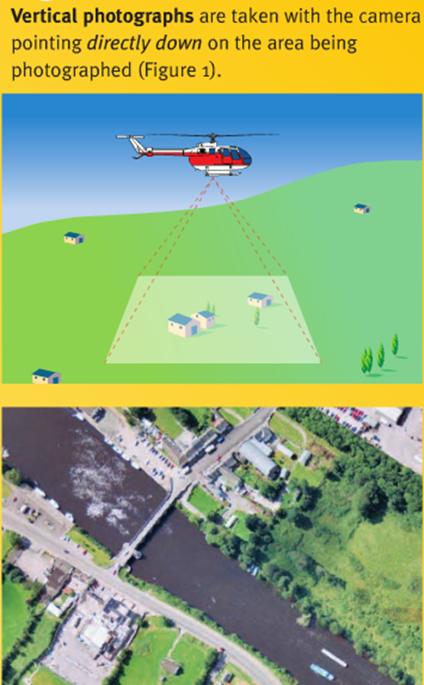
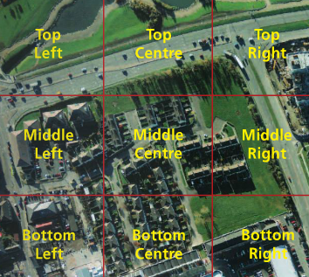
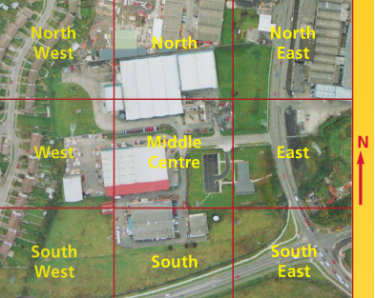

Slide 4
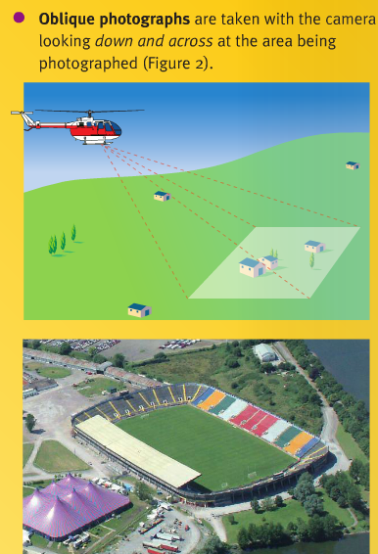
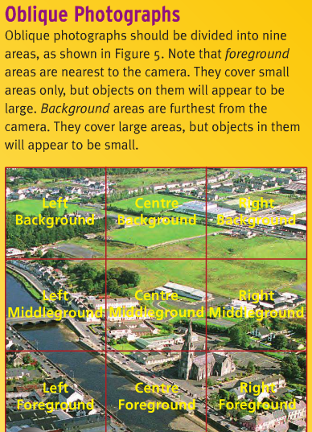

Slide 5
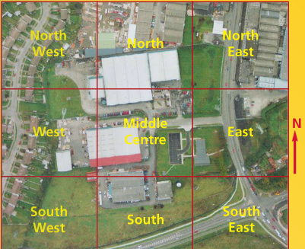
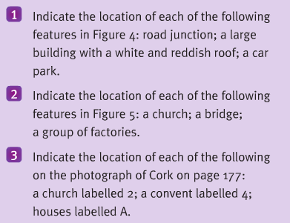

Slide 6
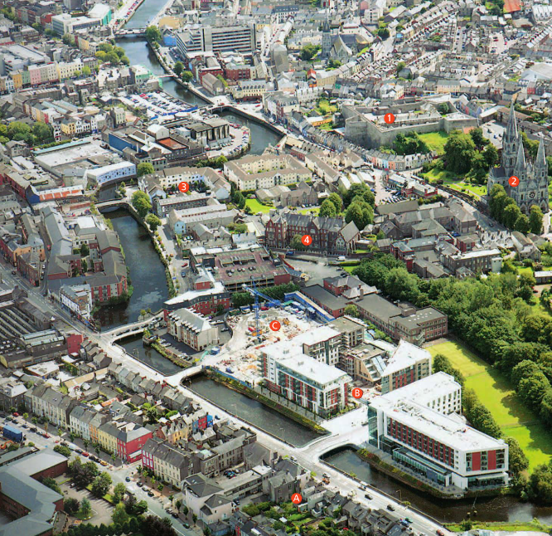

Slide 7
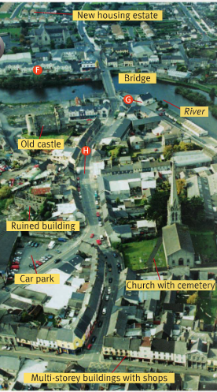
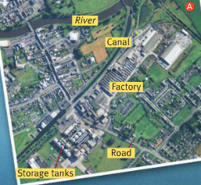

Slide 8
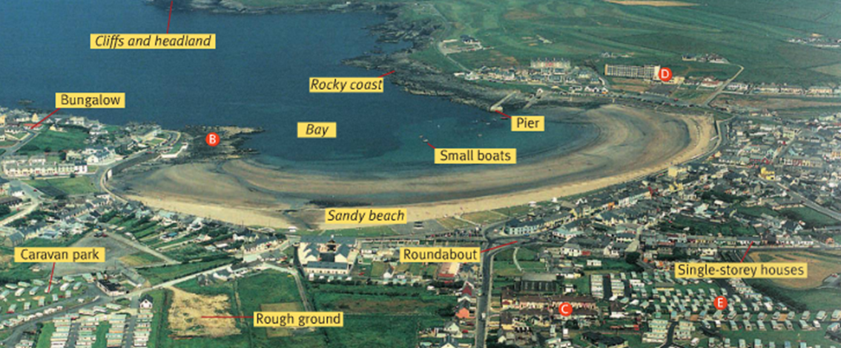

Slide 9
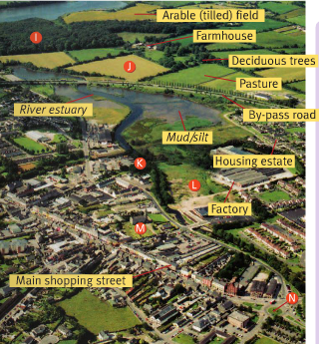
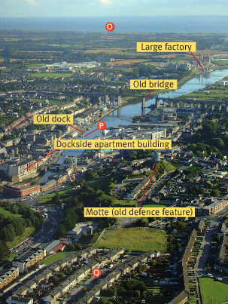

Slide 10
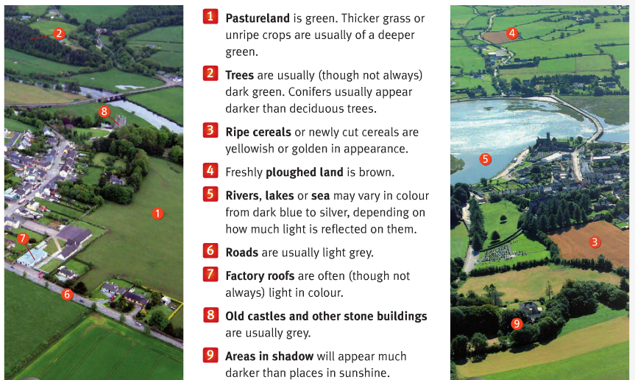

Slide 11
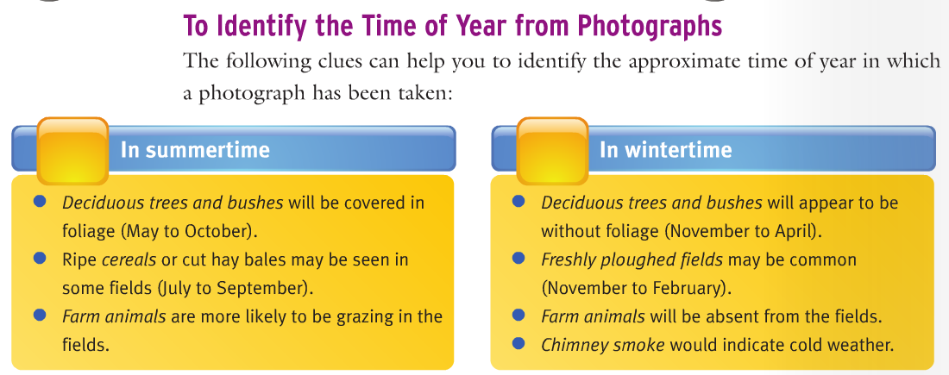
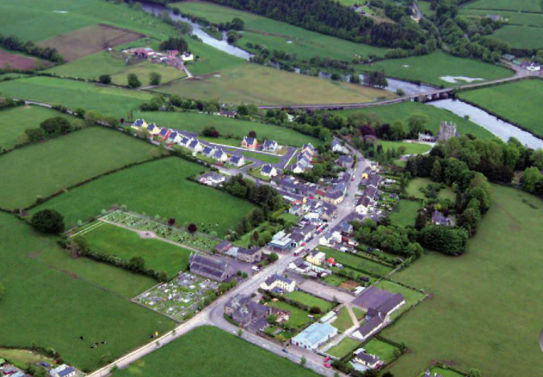

Slide 12
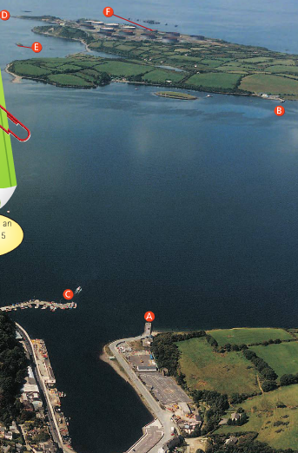

Slide 13
Rule 1: The top of a map is always north, so lay this on the table correctly in front of you.
Rule 2: Find the approx. area shown in the photo and lightly outline this area on the map.
Rule 3: Now, in the area you have marked on the map / and looking at the photograph, can you see any large obvious feature?
Rule 4: Turn the PHOTOGRAPH in whatever direction it takes for this feature to be in the same direction on the map.
Rule 5: Keeping the map and photo side by side, the top of the map is north and so should the photo now it is matching the map.

Slide 14
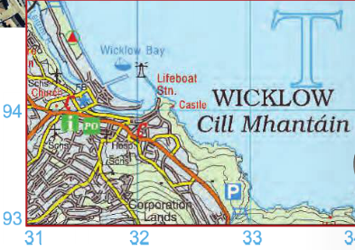
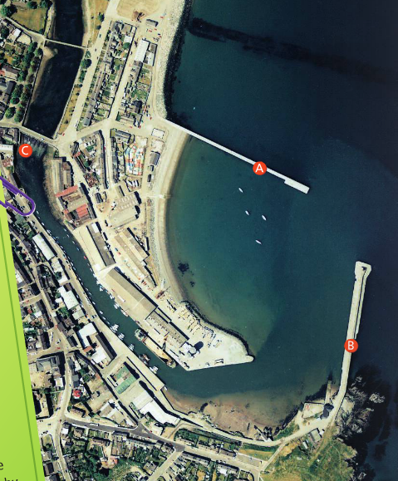

Slide 15
On a photograph you might see a castle, outline of a ringfort or a dolmen.
On a map you would read the symbols or words for each of the above….what are they?

Slide 16
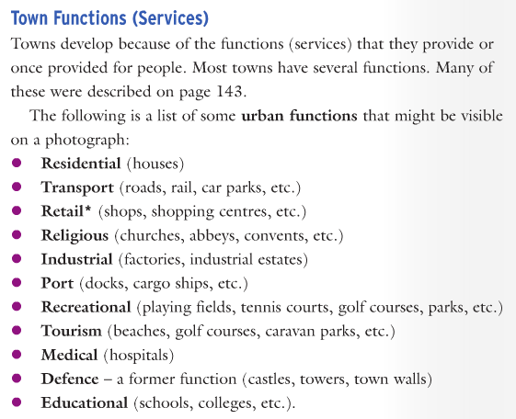
revise

Slide 17
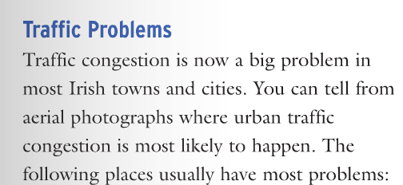
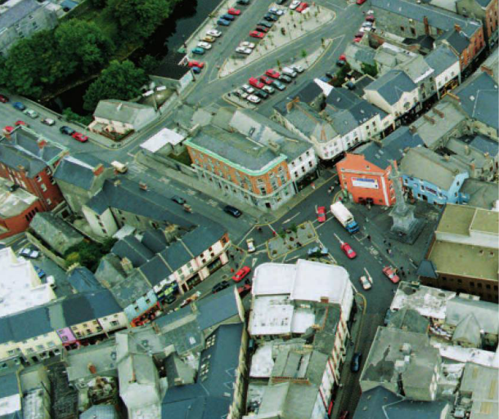

Slide 18
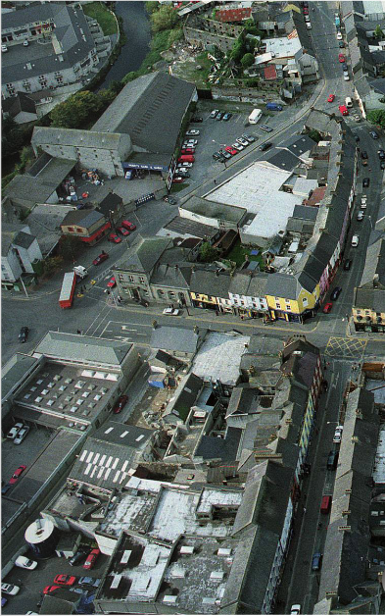
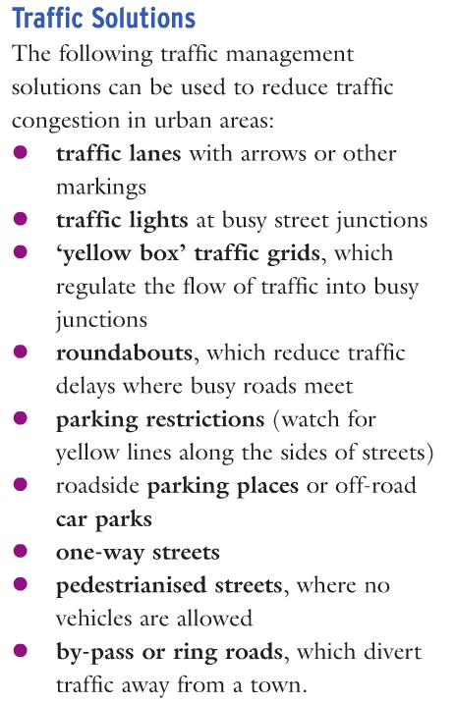

Slide 19
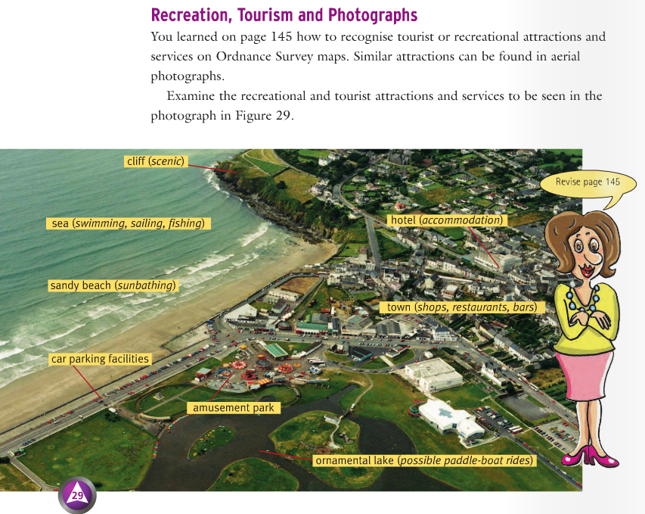

Slide 20
Main map and photo topics
Ordnance Survey Maps | Aerial Photographs

