Slide 1
Scale (ordnance survey maps)
Chapter 25

Slide 2
Grid References

Slide 3
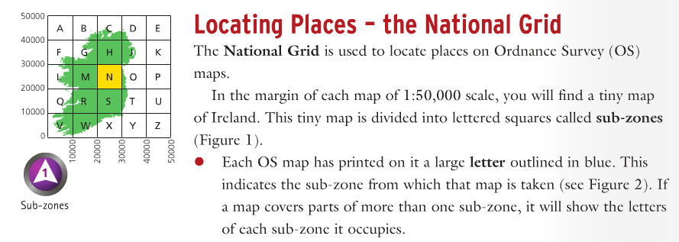
Each map we will study will have a large letter in blue (sometimes more!). These letters show us where in Ireland the map is of. What letters above will be on maps of Wexford.

Slide 4
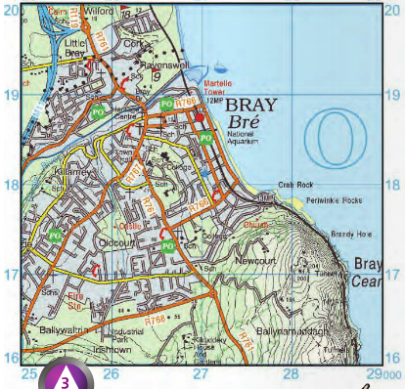
eastings
northings

Slide 5
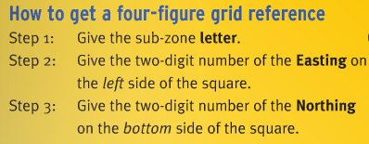
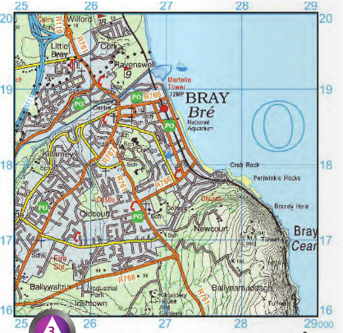
O
L E N

Slide 6
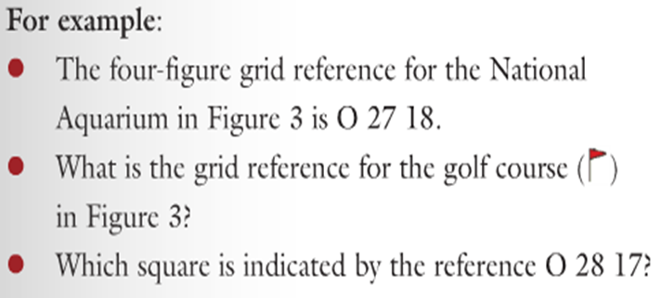

Slide 7
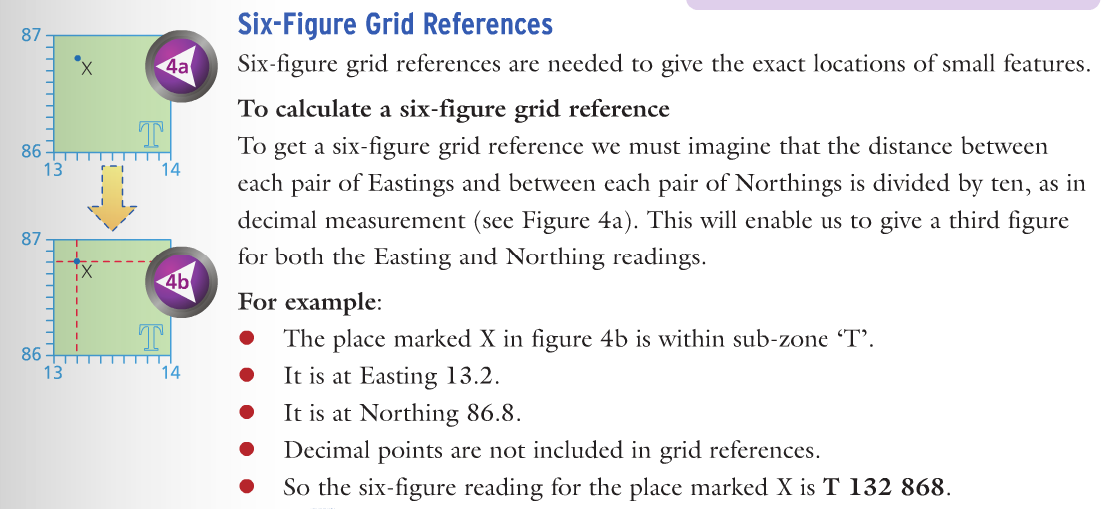

Slide 8
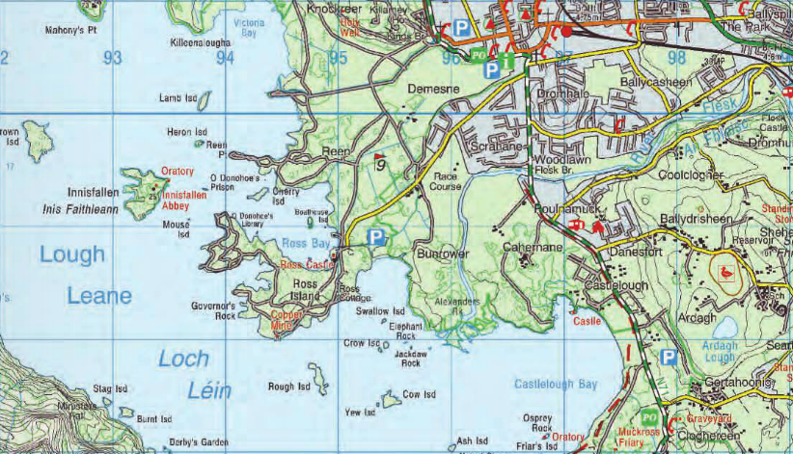

Slide 9
Height of land

Slide 11
Height of land in colour
Land above 600 metres
Land above 400 metres
200-400 metres
Land below 200 metres
High water mark
Low water mark
Beach / Sandy areas

Slide 12
Contour lines

Slide 13
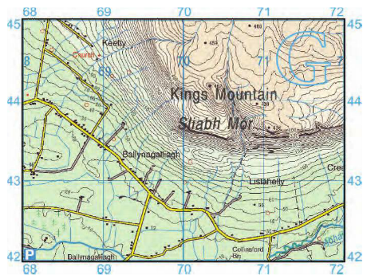

Slide 14
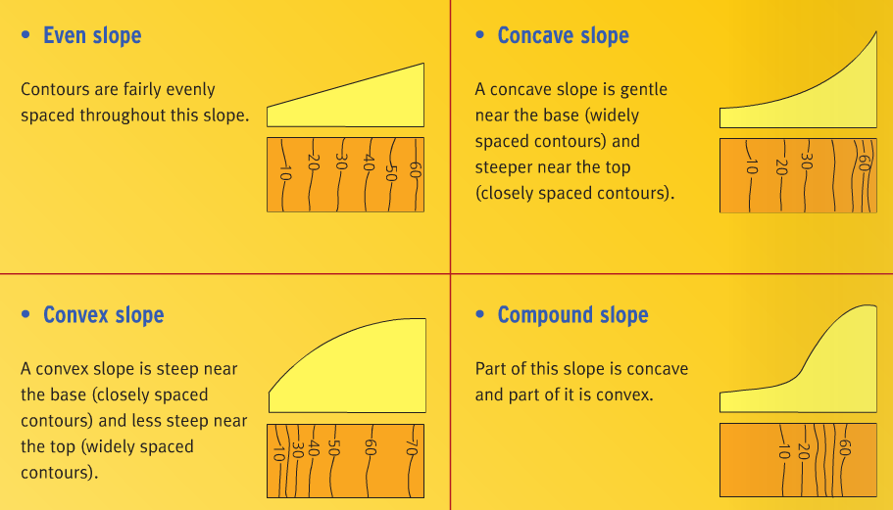
Contour lines and types of slope

Slide 15
Symbols on a map

Slide 16
